Slide 1




NEXT GEN EMPLOYABILITY PROGRAM
Creating a future-ready workforce
STUDENT DETAILS
College Name
Student Name : M.DANUSRI
Student ID : 513521104007
Annai Mira College Of Engineering and Technology

Slide 2

CAPSTONE PROJECT SHOWCASE
Project Title
Building Bus Reservation System using Python and Django
Abstract | Problem Statement | Project Overview | Proposed Solution | Technology Used | Modelling & Results | Conclusion

Slide 3
Abstract Online Bus Ticket Reservation System is a Web based application that works within a centralized network. This project presents a review on the software program "Online Bus Ticket Reservation System" as should be used in a bus transportation system, a facility which is used to reserve seats, cancellation of reservation and different types of route enquiries used on securing quick reservations. computerizing the traditional database, ticket booking and tracking bus and travel made. It maintains all customer details, bus details, reservation details. In order to achieve the design, Imo Transport Company (ITC) was chosen as a case study because of its strategic importance to Imo State. HTML , CSS, Java Script was used for the front-end of the software while the back end was designed using python and Django . The software achieved is capable of improving the customer hand and relationship management in ITC operations. It is recommended that despite the present functionality of the designed software, an additional functionality such as the use of E-mail to send tickets and notifications to the customer and in future, online payment using credit cards/debit cards will be implemented into the system.
Source :

Slide 4
Problem Statement Reservation system: Implement a user-friendly interface for customers to browse available buses, select preferred routes, and book seats effortlessly. The system should allow users to view bus schedules, seat availability, and fare details in real-time. User Authentication : Implement robust authentication mechanisms to verify the identity of users during the booking process. This includes registration, login, and profile management functionalities to personalize the user experience and maintain booking history. Scalability and Performance: Design the system architecture to handle a large volume of concurrent users and adapt to fluctuating demand during peak hours or seasons. Optimize database queries and server-side processes to ensure fast response times and minimal downtime. Accessability and compatability: Ensure that the Bus Reservation System is accessible across multiple devices and platforms, including web browsers, mobile apps, and kiosks. Support multiple languages and provide options for users with disabilities to navigate the system easily.
Source :

Slide 5
Project Overview Introduction: The Bus Reservation System is a comprehensive software solution designed to facilitate efficient management of bus ticket booking, seat allocation, and passenger information. This system aims to streamline the process of reserving bus tickets for both customers and administrators, enhancing the overall experience of bus travel. Objectives: Simplify the bus ticket booking process for passengers. Provide an intuitive interface for administrators to manage buses, routes, and reservations. Ensure accurate seat allocation and availability tracking. Generate comprehensive reports for analysis and decision-making. Enhance customer satisfaction through efficient service delivery. Features:. User Module: Registration and login for passengers. Search and book bus tickets based on various criteria (e.g., route, date, time). View seat availability and select preferred seats. Make secure online payments. Receive booking confirmation and e-tickets via email or SMS.
Source :

Slide 6
Proposed Solution a. User Interface: - User-friendly web and mobile interfaces for passengers to search, book, and manage their bus reservations. - Intuitive booking flow with search filters for route, date, time, and seat preference. - Secure authentication and payment gateway integration for seamless transactions. b. Admin Dashboard: - Comprehensive dashboard for administrators to manage buses, routes, bookings, and finances. - Real-time monitoring of bus occupancy, revenue, and performance metrics. - Tools for scheduling buses, assigning routes, and adjusting fares. c. Seat Allocation System: - Dynamic seat map display showing available and booked seats. - Algorithm for intelligent seat allocation based on passenger preferences and bus capacity. - Ability to reserve multiple seats together for groups or families.
.
Source :

Slide 7
d. Notifications and Reminders: - Automated email and SMS notifications for booking confirmations, reminders, and updates. - Alerts for seat availability changes or cancellations. - Customizable notifications for special offers or promotions.
e. Reporting and Analytics: - Generate detailed reports on bookings, revenue, occupancy rates, and route performance. - Analyze trends to optimize bus schedules, pricing strategies, and resource allocation. - Insights for decision-making and strategic planning.
f. Integration and Scalability: - Seamless integration with payment gateways for secure transactions. - API integration for route mapping, navigation, and real-time tracking. - Scalable architecture to accommodate growth in user base and transaction volume.
Source :

Slide 8
Implementation Plan:
Requirement Gathering: Conduct stakeholder meetings to gather requirements and define user stories.
System Design: Create wireframes and system architecture based on requirements.
Development: Implement frontend and backend components iteratively, following Agile methodologies.
Testing: Conduct unit testing, integration testing, and user acceptance testing (UAT) to ensure quality.
Deployment: Deploy the system in a staging environment for final testing and then to production.
Maintenance: Provide ongoing support, bug fixes, and updates based on user feedback and system performance.
Conclusion: The proposed Bus Reservation System offers a comprehensive solution to modernize and optimize bus ticket booking processes. By prioritizing user experience, scalability, and efficiency, the system aims to enhance customer satisfaction, increase revenue, and drive operational excellence in the transportation industry.
Source :

Slide 9


Technology Used
Front-end
Back-end
Source :

Slide 10
Modelling & Results
Improved Efficiency:
The system should significantly reduce the time and effort required for both users and administrators to make and manage bus reservations.
Automation of processes such as seat allocation and booking confirmations should streamline operations.
Enhanced User Experience:
Users should find it easy and intuitive to search for buses, select seats, and make reservations.
Clear communication through automated notifications should keep users informed about their bookings and any updates.
Increased Revenue:
By offering a convenient and hassle-free booking experience, the system should attract more passengers, leading to increased ticket sales.
Analysis of booking data and route performance should enable optimization of pricing strategies to maximize revenue.
Better Resource Utilization:
Insights gained from analytics should help administrators optimize bus schedules, routes, and capacities to minimize empty seats and maximize efficiency.
By identifying popular routes and peak travel times, resources can be allocated more effectively to meet demand.
Source :

Slide 11
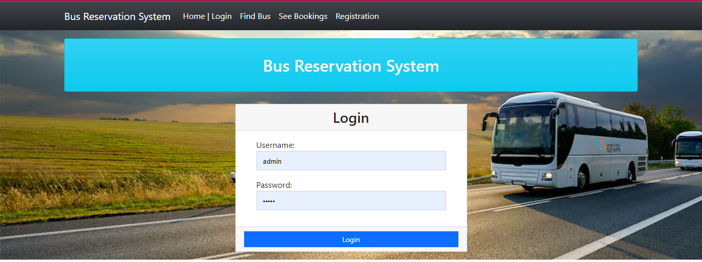
Homepage

Slide 12
Home/Login Page:
Welcome Message: Greet users and provide a brief overview of the bus reservation system.
Login Form: Allow registered users to log in using their credentials (username/email and password).
Registration Option: Provide a link or button for new users to register if they don't have an account.
Find Bus Page:
Search Form: Allow users to input their journey details including departure city, destination, travel date, and number of passengers.
Search Filters: Provide options to filter search results by bus operator, departure time, arrival time, fare range, etc.
Search Results: Display a list of available buses that match the search criteria, showing key information such as departure time, arrival time, duration, fare, and availability.
See Bookings Page:
Booking History: Display a list of past and upcoming bookings made by the user, including details like booking ID, itinerary, date of booking, status, and options for cancellation or modification.
Booking Details: Provide access to detailed information about each booking, including passenger details, seat numbers, fare breakdown, boarding/dropping points, etc.Registration Page:
Registration Form: Collect necessary information from new users including full name, email address, contact number, password, etc.

Slide 13
About-Us-Page
We are dedicated to providing a seamless and convenient booking experience for all your travel needs. Here's a little insight into who we are and what we stand for:
Our Mission
At our mission is simple: to make bus travel easy and accessible for everyone. We strive to connect passengers with reliable bus operators, offering a wide range of routes and schedules to suit every journey.
What Sets Us Apart
What sets us apart is our commitment to customer satisfaction. We prioritize transparency, reliability, and exceptional service in everything we do. With user-friendly booking features and round-the-clock support
Our Values
Transparency, reliability, and customer-centricity are at the core of our values. We believe in building trust with our customers through honesty, integrity, and professionalism. Your satisfaction is our top priority, and we go above and beyond to exceed your expectations.
Our Team
Behind [Your Company Name] is a dedicated team of professionals who are passionate about revolutionizing the way you book bus tickets. From developers and designers to customer support specialists, each member of our team plays a vital role in delivering a superior booking experience

Slide 14
Service-page
Our Bus Reservation System is designed to simplify the process of booking bus tickets for both individual and group travelers. Whether you're planning a solo journey, a family vacation, or a corporate trip, our platform ensures a seamless booking experience from start to finish.
Key Features:
User-Friendly Interface: Our platform boasts an intuitive user interface, making it easy for customers to navigate and book their bus tickets with minimal effort.
Extensive Route Network: We offer a wide range of routes, covering various destinations across the country. Whether you're traveling locally or across states, we've got you covered.
How it works
Findbus
Select
Book
Confirmation
Travel

Slide 15
Future Enhancements:
Integration with Public Transportation Networks:
Expand the system to integrate with other modes of public transportation such as trains, ferries, and subway systems, providing users with a comprehensive travel planning solution.
Dynamic Pricing Algorithms:
Implement dynamic pricing algorithms that adjust ticket prices based on factors such as demand, time of booking, route popularity, and availability of seats, optimizing revenue generation.
Enhanced Payment Options:
We willI implement the payment model by paying via Gpay or phone like.ntegrate additional payment options such as mobile wallets, cryptocurrency, and installment plans to cater to diverse payment preferences and improve convenience for users.
Emergency Assistance Features:
Introduce emergency assistance features such as panic buttons, emergency contact information, and real-time communication channels to ensure passenger safety and security during unforeseen events.
Blockchain-Based Ticketing System:
Explore the implementation of a blockchain-based ticketing system to enhance security, transparency, and fraud prevention in ticket transactions, ensuring trust and reliability for users and operators alike.
These future enhancements aim to further elevate the Bus Reservation System, providing users with advanced features, improved convenience, and a more personalized and engaging travel experience.

Slide 16
Conclusion
The implementation of the Bus Reservation System brings forth a multitude of benefits. For passengers, it offers a user-friendly platform where they can easily search for buses, select preferred seats, and make reservations with confidence.
Administrators and bus operators also reap the rewards of the Bus Reservation System. With features for managing buses, routes, schedules, and reservations, administrators can optimize operations, improve resource utilization, and make data-driven decisions to enhance service quality and efficiency. The system's reporting and analytics capabilities provide valuable insights that facilitate strategic planning, revenue optimization, and performance monitoring.
Looking ahead, future enhancements such as payment model like paying via gpay. dynamic pricing algorithms, and personalized recommendations promise to further elevate the Bus Reservation System, offering advanced features and a more tailored experience for users. As the system continues to evolve and adapt to changing needs and technological advancements, it remains committed to its mission of simplifying bus travel and providing exceptional service to passengers worldwide.
In essence, the Bus Reservation System stands as a cornerstone in the realm of transportation management, bridging the gap between passengers and bus operators, and paving the way for a more connected, efficient, and enjoyable travel experience for all.
Source :

Slide 17
Thank You!
Notes:
Thank You !!

